Slide 1
Finance and Accounting

Slide 2
DISCLOSURE REQUIREMENTS
An annual report is a document that public corporations must provide annually to shareholders that describes their operations and financial conditions
Shareholders use it to evaluate the firm's financial performance and to make investment decisions.
If the company is a public one, that is, if its shares are available for purchase by the public, through trading on a stock exchange, the stock exchange will impose additional disclosure requirements

Slide 3
Annual Report
General corporate information
Operating and financial highlights
Narrative text, graphics, and photos
Management's discussion and analysis (MD&A)
Financial statements, including the balance sheet, income statement, and cash flow statement
Auditor's report
Summary of financial data
Accounting policies

Slide 4
Balance Sheet
The purpose of the balance sheet is to show what the company owns –its assets – and what it owes, its liabilities. It is a snapshot of the state of the company at a particular point in time, normally at the end of the last
day of the company’s financial year.

Slide 5
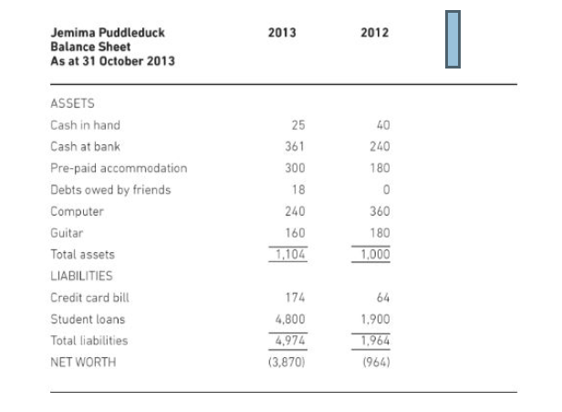
Balance Sheet

Slide 6
Balance sheet
Net worth: amount of cash which Jemima would have if all her assets were sold and all her debts paid off – in other words, how much, in financial terms, she is ‘worth’.

Slide 7
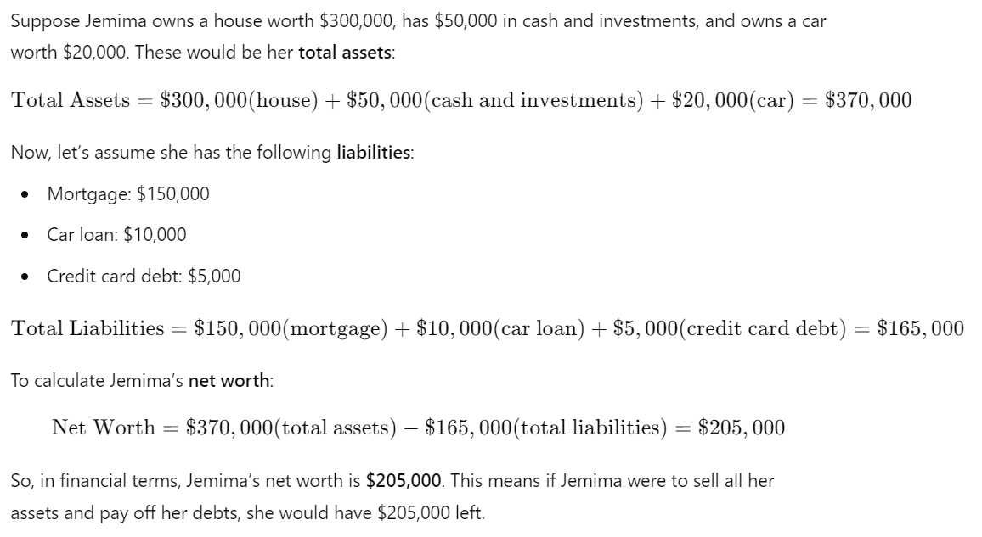
Balance sheet

Slide 8
Balance sheet
Standard accounting practice is to reduce the value of fixed assets each year to reflect the likely lifetime of each asset; the fall in the value of the asset from one year to the next is called the depreciation

Slide 9
Assets
Fixed Assets | Current Assets
Intangible/Tangible property and equipment that a business uses to produce income | That can be converted easily to cash In a short-term.
Cannot be convertible to cash immediately. Fixed assets are not expected to be sold in normal trading operations and their resale value is irrelevant; what is needed is a measure of their value to the company | Can be converted to cash immediately
Land, building, plant, computers, machinery, vehicles and furniture | Cash, inventory

Slide 10
Assets
Fixed Assets | Current Assets
Purchase price - depreciation or according to company’s depreciation policy | Cost or market value whichever is low
contribute to the company’s productive capacity and are held primarily for the purpose of creating wealth | current assets are items which are bought and sold in the course of its day to day trading activities

Slide 11
Example: Cost or market value whichever is low
company has a stock of 1,000 Books
Sells at Rs. 10 for each
Cost Rs. 2 each to produce.
On balance sheet current asset will appear as Rs. 2000(cost price) rather than (10,000)

Slide 12
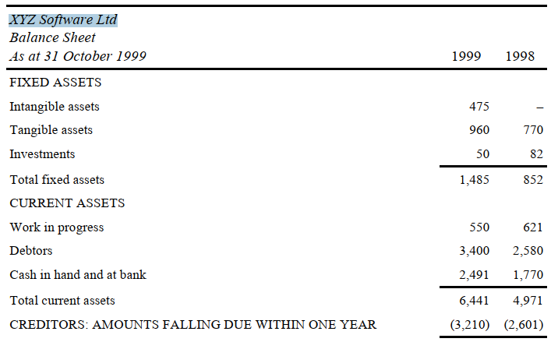
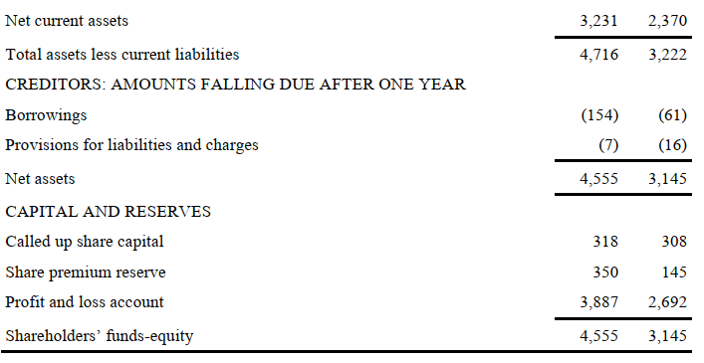

Slide 13
Assets
if a company buys a car to enable one of its sales staff to operate more effectively, this is a fixed asset but, if a car dealer buys a car in order to resell it as part of the business, this is a current asset.

Slide 14
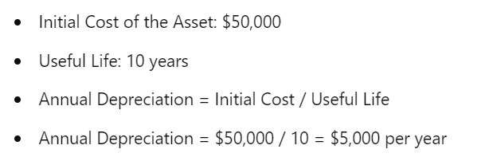
Depreciation: Straight Line Method
Decide how many years the asset will continue to be useful for
divide its initial cost by that number to get the
annual depreciation
Each year reduce by the amount of annual depreciation until the value of the asset reaches zero.

Slide 15
Depreciation
Suppose a company buys a large database server costing Rs.100,000 and expects to use it for five years. Then the annual depreciation will be Rs.20,000 (100,000/5) and the values shown in the balance sheet will be Rs.80,000 at the end of year 1, Rs.60,000 at the end of year 2, Rs.40,000
at the end of year 3, Rs.20,000 at the end of year 4, and zero at the end of year 5.

Slide 16
DEPRECIATION
Generally valued on the basis of historic cost
If a fixed asset is sold for a sum higher than its depreciated value, the company must show the difference as income

Slide 17
Depreciation
Consider a payroll package. A company buys such a package because
It will help it to carry out part of its day-to-day operations more
efficiently.
The package will be bought with the intention of using it for some time, at least five years and probably 10 or 15. Logically, the
Package should be treated in the same way as a piece of machinery. It
should be treated as a fixed asset and the initial cost depreciated over
its useful lifetime. The rules of accounting allow this to be done.
But, because software is intangible, many companies treat the cost of
buying it as current expenditure

Slide 18
Working Capital
The figure obtained by subtracting the current liabilities from the current assets, referred to as net current assets in the example, is also known as the working capital. It represents the amount of money invested in the day-to-day operations of the company
Notes:
‘debtors’ item refers to invoices that the company has issued but
which have not yet been paid

Slide 19
Creditors
Creditors: amounts falling due after one year’ refers to long term debts. These may be long term borrowings or they may be liabilities, that is sums that the company expects to have to pay at some time in the future
Notes:
‘current liabilities: amounts falling due within one year’
refers to debts that the company has and is committed to repaying within
one year

Slide 20
Called up share capital
Amount raised from the par value of the shares that the company has issued
Successful company decides to issue more shares, these are often sold at more than there par value. The extra is known as the share premium
Notes:
Capital and reserves is the difference between total assets and total liabilities in the balance sheet

Slide 21
Profit and Loss account
how much money has been received and how much has been spent in a given period
Also known as income statement/ income and expenditure account
It does not include money borrowed or received from the sale of equity nor does it include expenditure on acquiring fixed assets

Slide 22
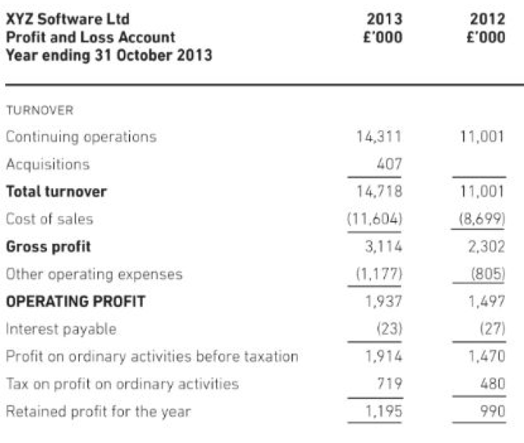
Profit and Loss Account
Notes:
Turnover is an accounting concept that calculates how quickly a business conducts its operations. Most often, turnover is used to understand how quickly a company collects cash from accounts receivable or how fast the company sells its inventory.

Slide 23
Cash Flow
The link which ties the balance sheet and the profit and loss account to the capital expenditure is the cash flow statement
Cash is defined as ‘cash at bank and in hand and cash equivalents less bank overdrafts and other borrowings repayable within one year of the accounting date’.
Notes:
Capital expenditure affects the balance sheet but the balance sheet does not give
sufficient information to deduce how much this expenditure amounts to
and how it was funded

Slide 24
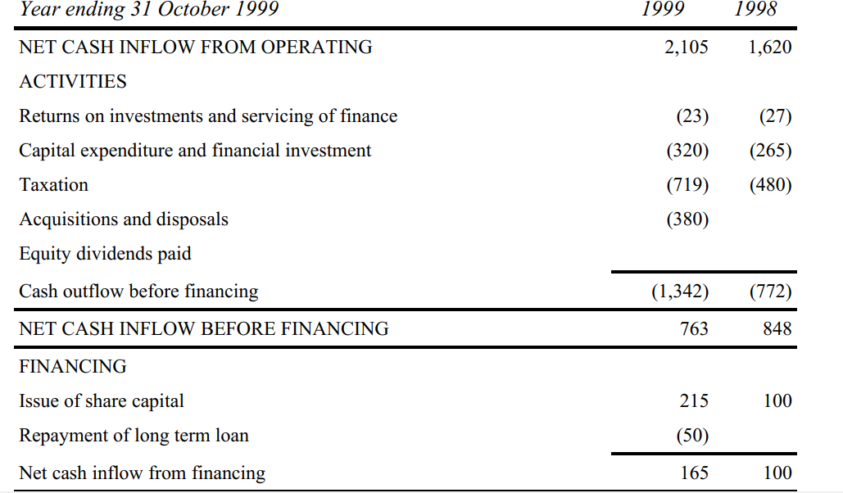

Slide 25
